Slide 1

B.Tech Project First - Evaluation
NYAYSETU: AN AI-ASSISTED LEGAL SUGGESTION SYSTEM
Presented by :
Anupam Kumar Singh (2023305089)
Akshay Pratap Singh (2023409091)
Prince Kumar (2023393156)
Under the Supervision of:-
Prof. (Dr.) Velayudham Sathiyasuntharam
Professor, CSE
DEPARTMENT OF COMPUTER SCIENCE & ENGINEERING
SHARDA SCHOOL OF ENGINEERING AND TECHNOLOGY
September 2026
1

Slide 2
Approval from guide for the evaluation

Slide 3
Contents of the Presentation
Introduction
Project Objectives
Literature Survey
Research Gap
Team Members & Responsibilities
Meeting Details
Feasibility Analysis
Project Constraints
Project Requirement Specifications
Project Progress
Conclusion

Slide 4
Introduction of the project
Access to legal information can be difficult because of limited legal awareness, economic constraints, geographical barriers, and complex legal procedures.
Users often describe their legal problems in ordinary language rather than formal legal terminology.
NyaySetu aims to interpret natural-language legal concerns, identify relevant legal categories, and provide preliminary informational guidance.
The system also aims to facilitate connection with appropriate legal professionals while maintaining clear ethical boundaries and avoiding the presentation of AI output as legal advice.

Slide 5
Project Objectives
To develop an AI-assisted system that can understand users' legal concerns expressed in natural language and identify relevant legal categories.
To provide preliminary and understandable legal-information guidance based on the identified category while maintaining appropriate disclaimers and ethical boundaries.
To facilitate access to legal professionals by connecting users with lawyers according to relevant profiles and specializations.

Slide 6
Literature Survey (1/2)
Paper | Author | Year | Problem Addressed | Method Used | Key Contribution | Limitation
Text Classification: A Survey | Fabrizio Sebastiani | 2002 | Automatic text categorization | Machine learning classification | Established foundations for text classification | Traditional ML limitations
BERT: Pre-training of Deep Bidirectional Transformers | Devlin et al. | 2019 | Language understanding | Transformer-based pretraining | Improved contextual language representation | Computational requirements
Legal-BERT: The Muppets straight out of Law School | Chalkidis et al. | 2020 | Legal-domain language understanding | Domain-specific BERT | Improved legal NLP representation | Domain and data dependency
Speech and Language Processing | Jurafsky & Martin | 2024 | NLP and language processing | Statistical and neural NLP | Comprehensive NLP foundations | Broad scope
Natural Language Toolkit | Bird, Klein & Loper | 2009 | NLP processing | Python NLP tools | Practical NLP processing framework | General-purpose NLP

Slide 7
Literature Survey (2/2)
Paper | Author | Year | Problem Addressed | Method Used | Key Contribution | Limitation
A Survey of Legal Text Classification | Legal NLP researchers | — | Classification of legal documents | ML and NLP techniques | Demonstrates applicability of classification | Domain-specific datasets
Attention Is All You Need | Vaswani et al. | 2017 | Sequence modelling | Transformer architecture | Introduced Transformer architecture | High computational requirements
Word2Vec: Efficient Estimation of Word Representations | Mikolov et al. | 2013 | Word representation | Word embeddings | Distributed semantic representations | Limited contextual understanding
Legal Text Processing and Classification | Various researchers | — | Legal document analysis | NLP and ML | Supports automated legal text analysis | Data quality challenges
Conversational AI Systems | Various researchers | — | Natural-language interaction | Retrieval and generative approaches | Enables conversational assistance | Accuracy and trust concerns

Slide 8
Research Gap
Lack of Integrated Legal Assistance – Existing approaches often focus separately on legal text classification, conversational systems, or lawyer consultation rather than integrating these components into one accessible workflow.
Limited Personalization – General legal-information systems may not sufficiently consider the user's specific concern or relevant legal category.
Accessibility Challenges – Legal information can remain difficult to understand for users without formal legal knowledge.
Ethical and Trust Concerns – AI-assisted legal systems require clear boundaries, privacy considerations, disclaimers, and appropriate human professional involvement.

Slide 9
Team Members & Responsibilities
Member | Responsibility
Anupam Kumar Singh | AI/NLP research, system architecture, backend and AI-assisted legal-information workflow
Akshay Pratap Singh | Frontend development, authentication, user interface and lawyer-side functionality
Prince Kumar | Database design, testing, documentation and system integration

Slide 10
Meeting Details(1/2)
Week | Date | Discussion / Meeting Details
Week 1 | 26/01/2026 | Topic finalized and project workflow planning discussed with mentor.
Week 2 | 02/04/2026 | Progress, evaluation criteria, and initial documentation preparation reviewed.
Week 3 | 05/04/2026 | Documents verified; corrections and improvements suggested by mentor.
Week 4 | 08/04/2026 | Literature survey process and related research papers discussed.
Week 5 | 15/04/2026 | Zeroth evaluation documents reviewed and implementation phase approved.

Slide 11
Meeting Details(2/2)
Week | Date | Discussion / Meeting Details
Week 6 | 20/06/2026 | Review paper discussed with mentor, changes to add Result and Discussion section were suggested.
Week 7 | 27/07/2026 | Required changes in the paper completed and the review paper was submitted.
Week 8 | 10/08/2026 | Changes to be made in the paper according to conference remarks were discussed; comparative graph was suggested.
Week 9 | 17/08/2026 | Suggested changes and comparative graph were completed; modified paper was submitted.
Week 10 | 24/08/2026 | Project implementation approach and further submission of the paper to multiple conferences were discussed.

Slide 12
.
Feasibility Analysis(1/2)
Technical Feasibility
The system can be developed using Python-based backend and modern web technologies.
Natural-language processing and machine-learning techniques are available for legal-category identification.
Individual authentication, user-management, lawyer-profile and AI-assisted modules can be developed and integrated into a single workflow.
Economic Feasibility
Open-source software, frameworks, libraries and development tools can be used.
Existing computing and development resources can be utilized, keeping additional project costs low.

Slide 13
Feasibility Analysis(2/2)
Operational Feasibility
The system follows a structured workflow from user registration and authentication to legal-information assistance and potential lawyer consultation.
The results can be presented through a simple web interface for users and legal professionals.
Research Feasibility
Existing research in NLP, machine learning, legal text classification and conversational systems provides sufficient theoretical support.
The proposed approach can be evaluated using suitable classification, usability and system-performance measures.

Slide 14
Project Constraints(1/2)
Implementation Constraints
Integrating NLP, classification, web application and lawyer-consultation components can increase implementation complexity.
Legal-language processing may require domain-specific data and suitable preprocessing.
AI-based processing may require additional computational resources depending on the selected models.
Data Constraints
Availability of suitable and reliable legal datasets may be limited.
Variations in user language, legal terminology and informal descriptions can affect classification performance.

Slide 15
Project Constraints(2/2)
Model Constraints
Machine-learning models may require task-specific training and adjustment for effective legal-category classification.
The quality of predictions depends on the relevance and quality of the available training data.
Evaluation Constraints
Legal-information assistance cannot be evaluated using a single metric alone.
Classification performance, response relevance, factual reliability, usability and ethical considerations may require different evaluation approaches.

Slide 16
Project Requirements Specifications
Software Requirements
Programming Language: Python, TypeScript
Backend Framework: FastAPI
Frontend Framework: Next.js / React
Database: PostgreSQL
ORM: SQLAlchemy
Migration Tool: Alembic
Authentication: JWT and Refresh Tokens
AI/NLP: Machine Learning and NLP-based legal classification
Development Environment: VS Code / Web Development Environment

Slide 17
Project Requirements Specifications
Hardware Requirements
Processor: Intel i5 / Ryzen 5 or equivalent
RAM: Minimum 8 GB, 16 GB recommended
Storage: Minimum 10–20 GB available
GPU: Optional, depending on AI model requirements
Internet: Stable internet connection for dataset and model access

Slide 18
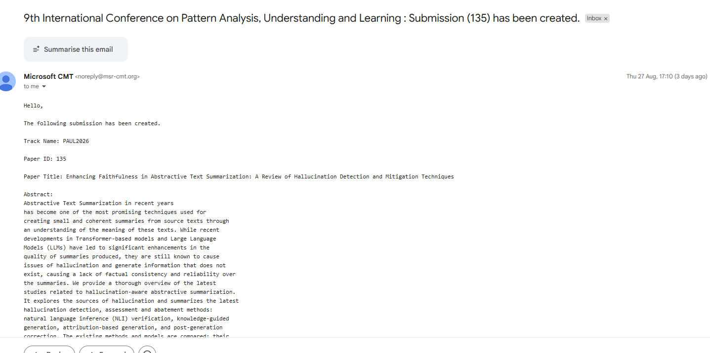
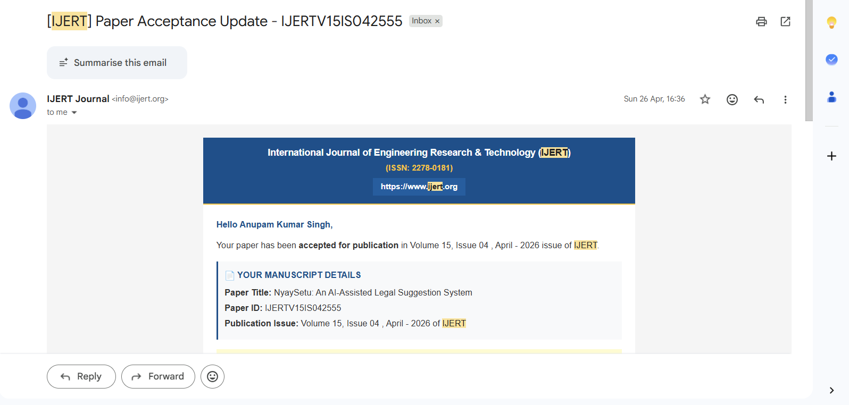
Project Progress (1/2)

Slide 19
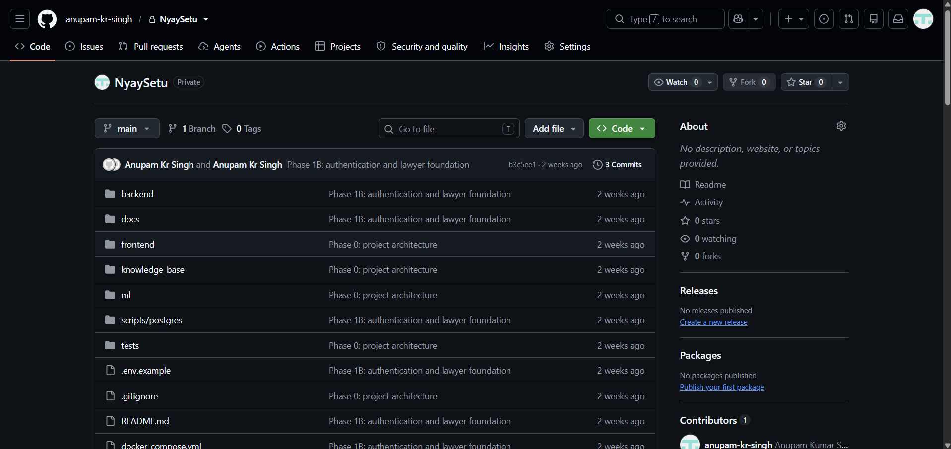
Project Progress (2/2)

Slide 20
Conclusion
NyaySetu aims to improve access to legal information by allowing users to describe their legal concerns in ordinary language.
The project combines web-based user management, legal-category identification and AI-assisted informational guidance with access to legal professionals.
The proposed approach focuses on making legal information more accessible while maintaining privacy, disclaimers and appropriate ethical boundaries.
The research review, system requirements, architecture and initial implementation foundations have been developed, providing a basis for further AI integration, evaluation and project completion.

